Slide 1
Yelp Review Classification & Sentiment Analysis
Jonathan Beatty | DSI 2018

Slide 2
Problem Statement
Can Yelp reviews be better analyzed to give Restaurant Operators more actionable insights?
What are some keywords that are considered positive or negative in reviews?
Can we classify yelp reviews as positive or negative?

Slide 3
The Data
Gathered from Yelp Kaggle competition
Almost 6 million reviews, only roughly 3.5 million from restaurants
Gathered from multiple states/countries(I remove all non english reviews)
Will use review text for topic modeling/classification
We work on a subset of the data to save memory

Slide 4
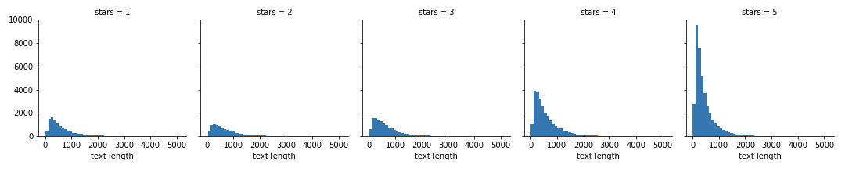
Exploratory Data Analysis
Text length for negative reviews is much longer than for positive reviews

Slide 5
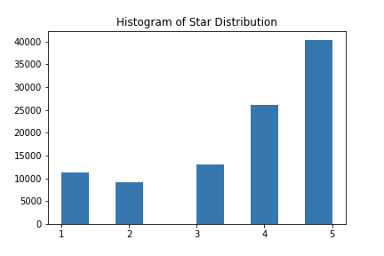
EDA continued
Imbalanced classes are an issue on yelp, the majority of reviews are 4-5 stars

Slide 6
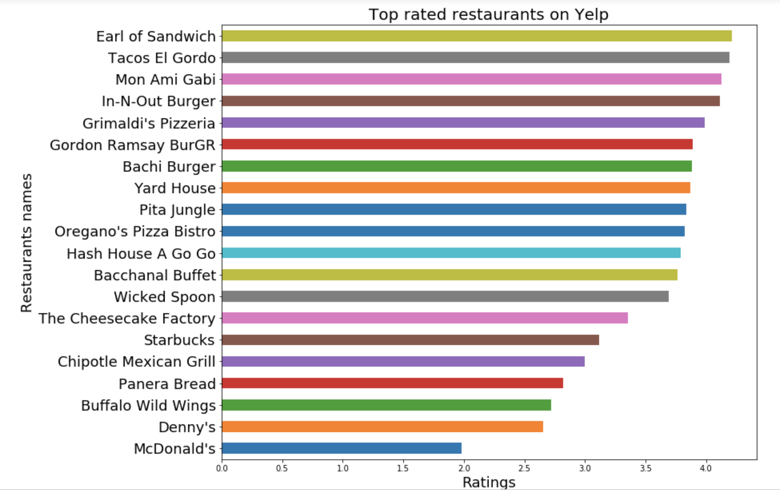
Top 20 most rated by star count

Slide 7
Topic Modeling
What is Topic Modeling?
1. Gives structure to a collection of documents(reviews)
2. Clustering technique to group words that have some form of relation
3. Can be used to analyze different topics in your corpus(collection of reviews) to gain insight into how a word is being used in its surroundings

Slide 8
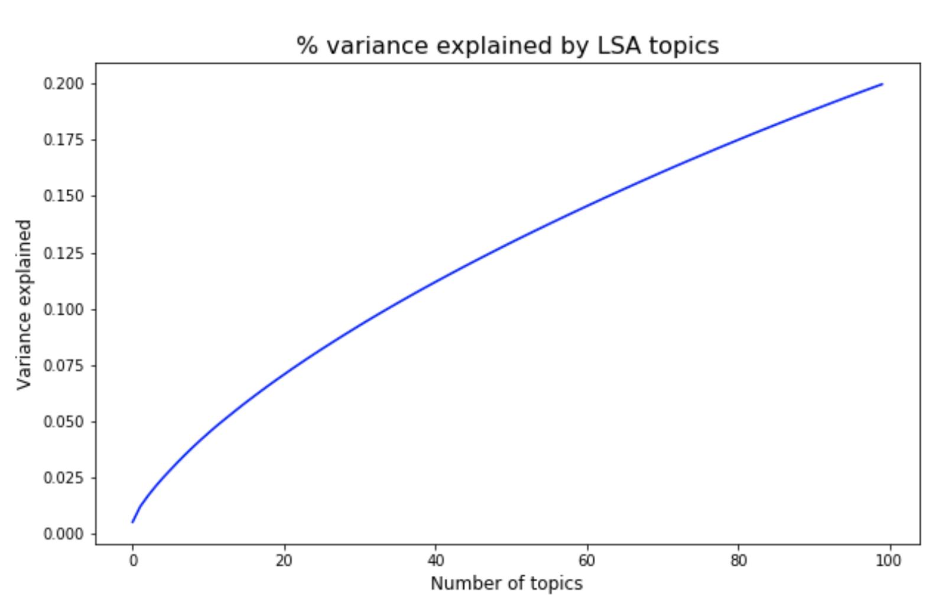
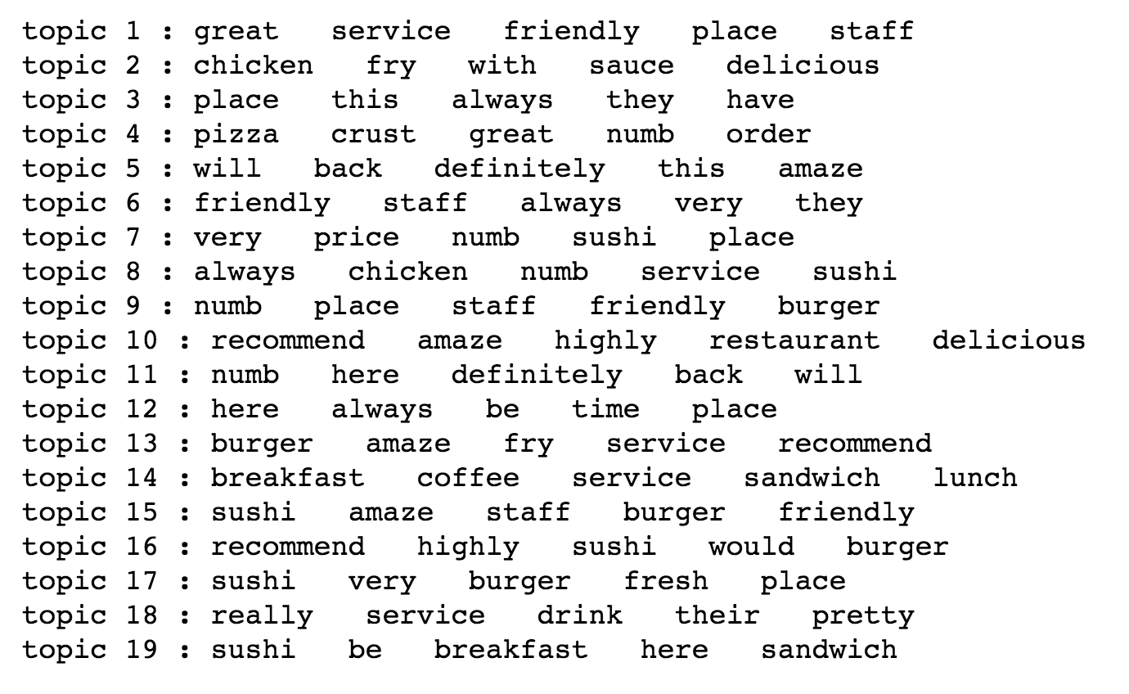
Latent Semantic Analysis(LSA)
Latent Semantic Analysis (LSA) is a theory and method for extracting and representing the
contextual-usage meaning of words by statistical computations applied to a large corpus of
text.
Worked with 100 topics, any more and it would take too much memory and computing power

Slide 9
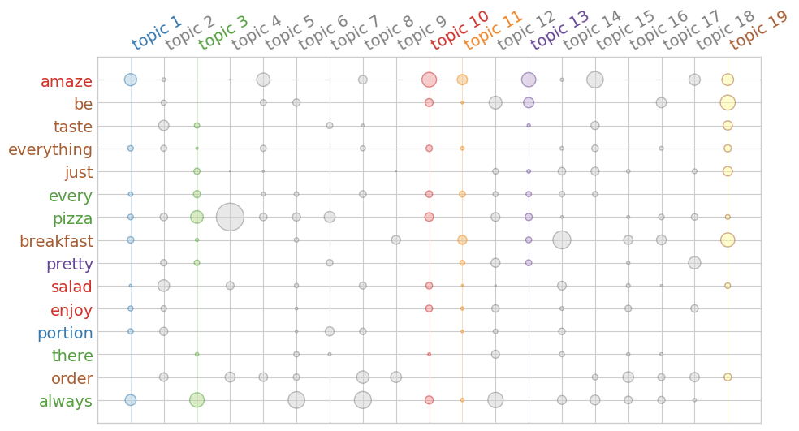
LSA Termite Plot

Slide 10
VADER Sentiment Analysis
VADER(Valence Awareness Dictionary for Sentiment Reasoning) is a qualitative and quantitative analysis tool in python which is specifically attuned to sentiment in microblog-like contexts.
4 different scores, compound, negative,neutral and positive
Can be done to individual words or to full sentences or paragraphs
Very useful in seeing trends in how the computer represents positivity and negativity

Slide 11
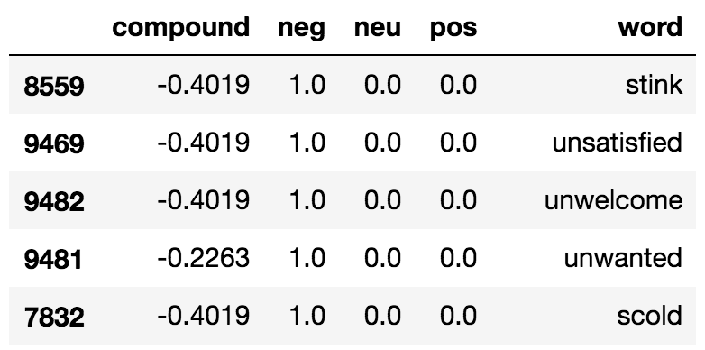
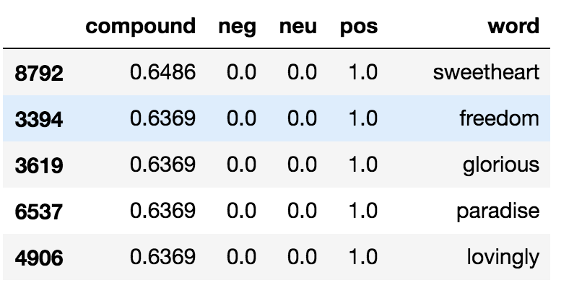
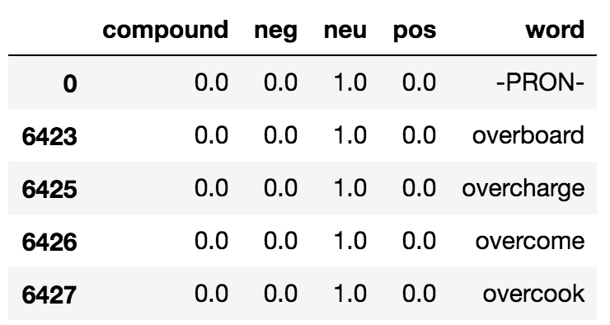
Top 5 words
Negative
Positive
Neutral
Compound

Slide 12
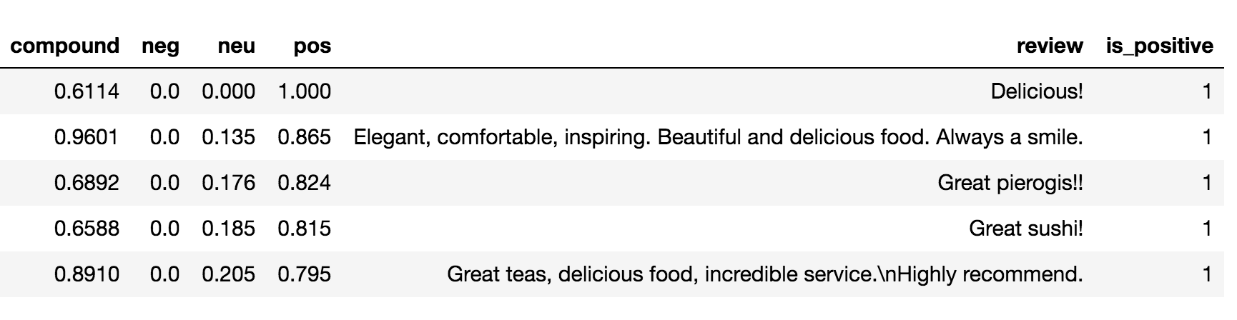
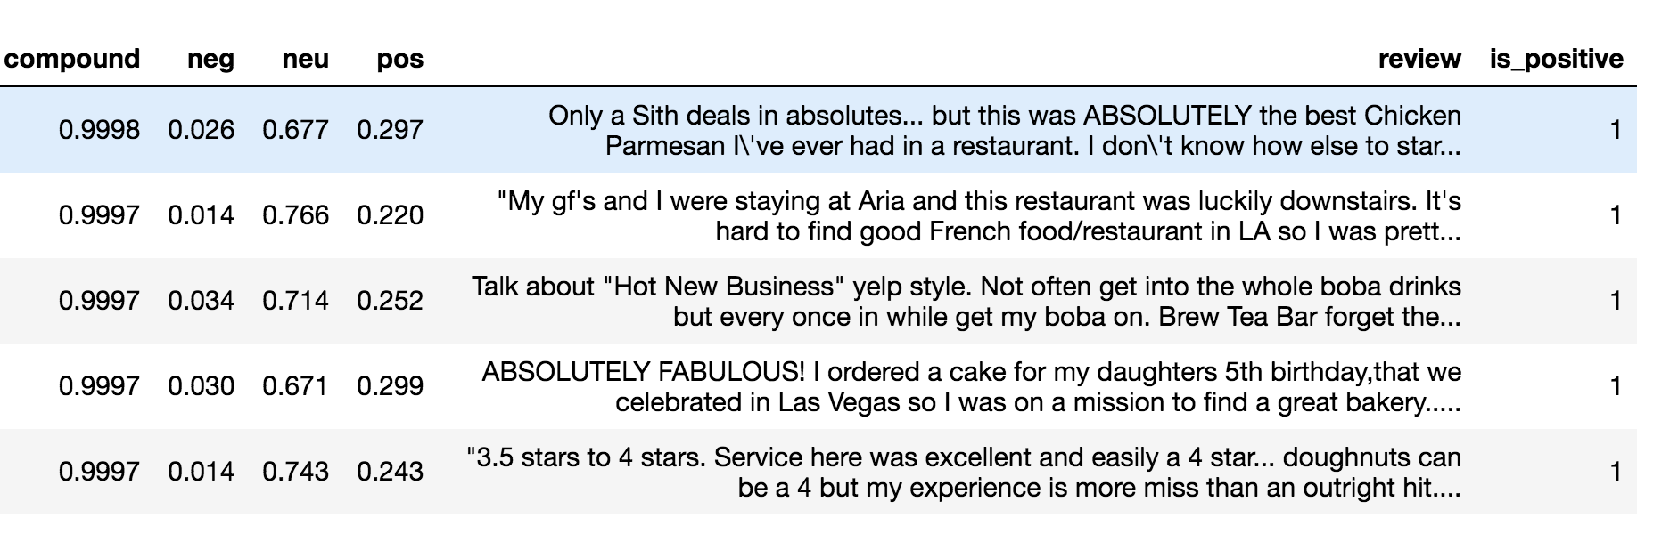
Positive and Compound Comparison

Slide 13
Word2Vec Analysis
Word2vec is a group of related models that are used to produce word embeddings
These models are shallow, two-layer neural networks that are trained to reconstruct linguistic contexts of words.
Word vectors are positioned in the vector space such that words that share common contexts in the corpus are located in close proximity to one another in the space.

Slide 14
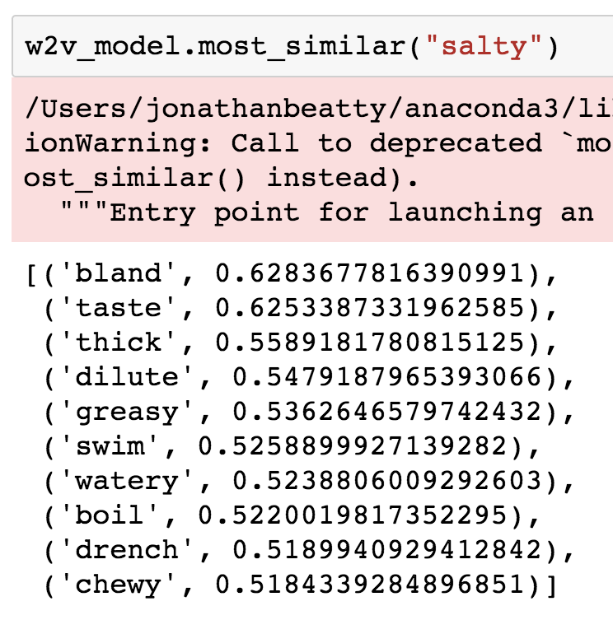
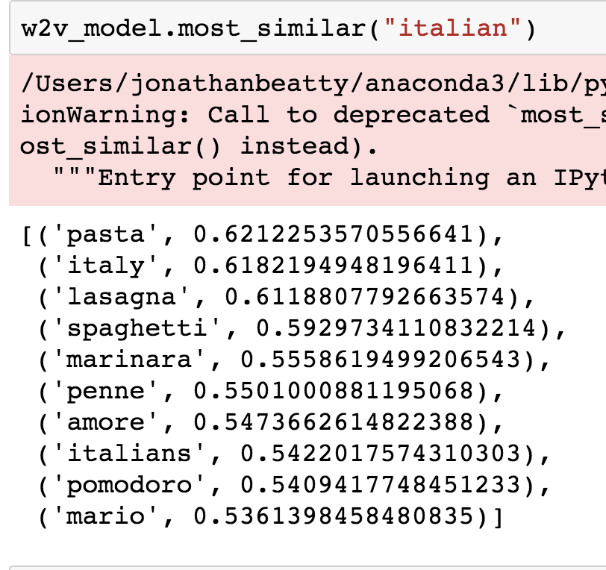
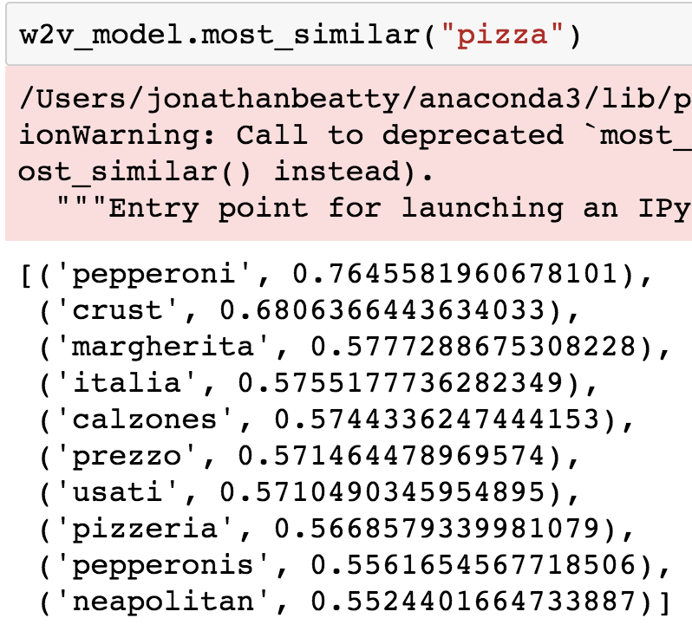
Most Similar Function

Slide 15
Binary Classification Modeling
Logistic Regression- Used for a basic model, performs very well on binary classification
2. Linear Support Vector Classifier- All the benefits of a basic SVC but works on the one vs. all principle, faster processing.

Slide 16
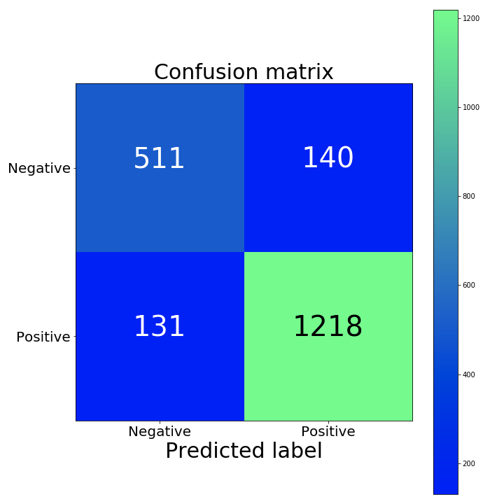
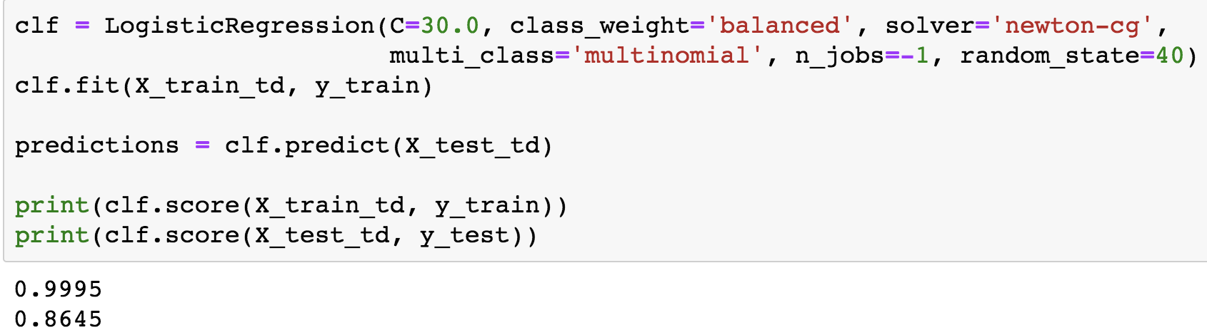
Logistic Regression

Slide 17
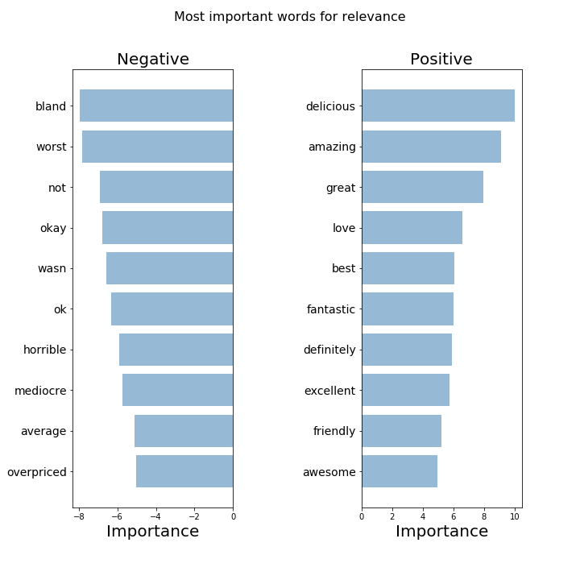
Logistic Regression
Feature Importances
Do we see anything unexpected?
How can this help restaurants better serve their guests?

Slide 18
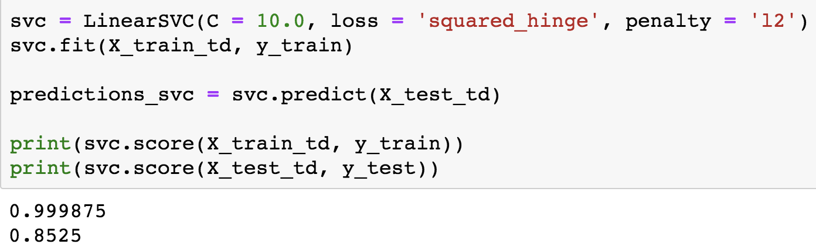

Linear Support Vector Classifier

Slide 19
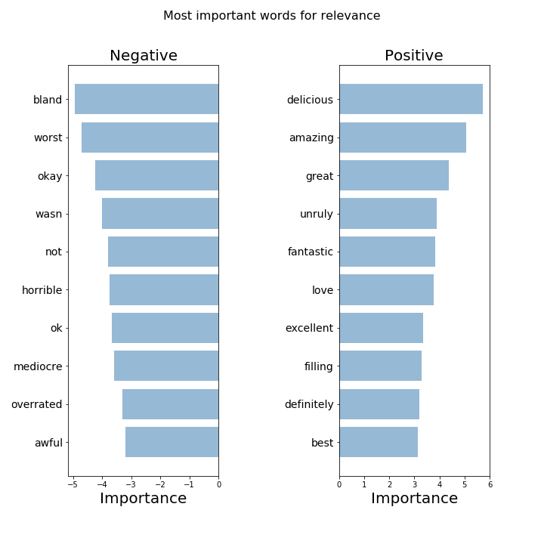
Linear SVC
Do we see anything unexpected?
How can this help restaurants better serve their guests?

Slide 20
Future Work
Set up a multi class classification neural network to improve upon the binary classification model.
Group reviews by state and analyze differences between geographical regions.
Learn to use AWS or Google cloud to run models on the full dataset.

